Slide 1
Putting some POSTMAN in your testing
Postman pt.2 for Restful Services – editing and coding scripts / sequencing tests
150 hours of testing: theme 2: Headless

Slide 2
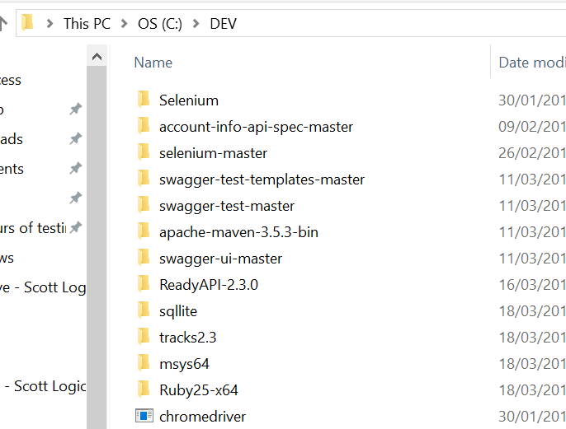
SETTING UP your local test environment
Note: The default installation folder for any and all tools \ training materials should be C:\DEV to make them easy to find again.

Slide 3
SETTING UP your local test environment
Install GIT to be able to save your code a GIT repository. This process and the related terminology is described here: http://newcoder.io/begin/save-your-progress/
Install Postman: https://www.getpostman.com/apps
Bookmark the Swagger Pet store JSON file: https://github.com/OAI/OpenAPI-Specification/tree/master/examples/ (The expanded file will give the most functions for testing)
Bookmark the online swagger editor: http://editor.swagger.io//#/
View the Pet store file in RAW version and paste the code into the Swagger editor
Save the Pet store code as a local YAML file (instructions on next page)
Now we’re ready to go!

Slide 4
SETTING UP your local test environment
A note on viewing APIs in POSTMAN.
You can also download the Pet store JSON file into Postman but going through Swagger gives you a nicer interface to see the requests supported by the API. It’s entirely up to you how you set up your environment.
If you do not have access to the Swagger file (in JSON/YAML format) to be tested. You can view the webpage in Chrome developer tools and paste the curl requests directly into POSTMAN.
A note on dropping Swagger files into Postman: The Postman swagger import doesn't read all of the internal objects which means that some request bodies will be incomplete so if possible, it is best not to build your requests UI in this way. To address this problem, Postman have brought out a new open source converter which can be added to your Postman installation: http://blog.getpostman.com/2018/03/02/sync-your-specs/

Slide 5
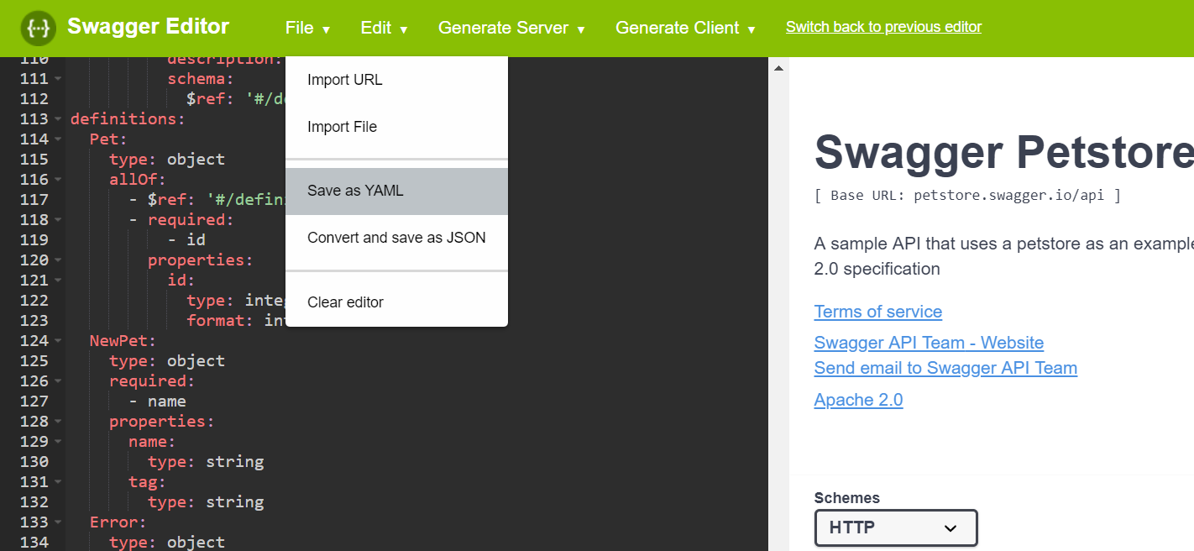
SETTING UP your local test environment
Save the JSON file as a YAML file In Windows, this will be saved to your downloads folder
Move to a memorable location. Please don’t ask me to tell you which one because I will actually cry

Slide 6
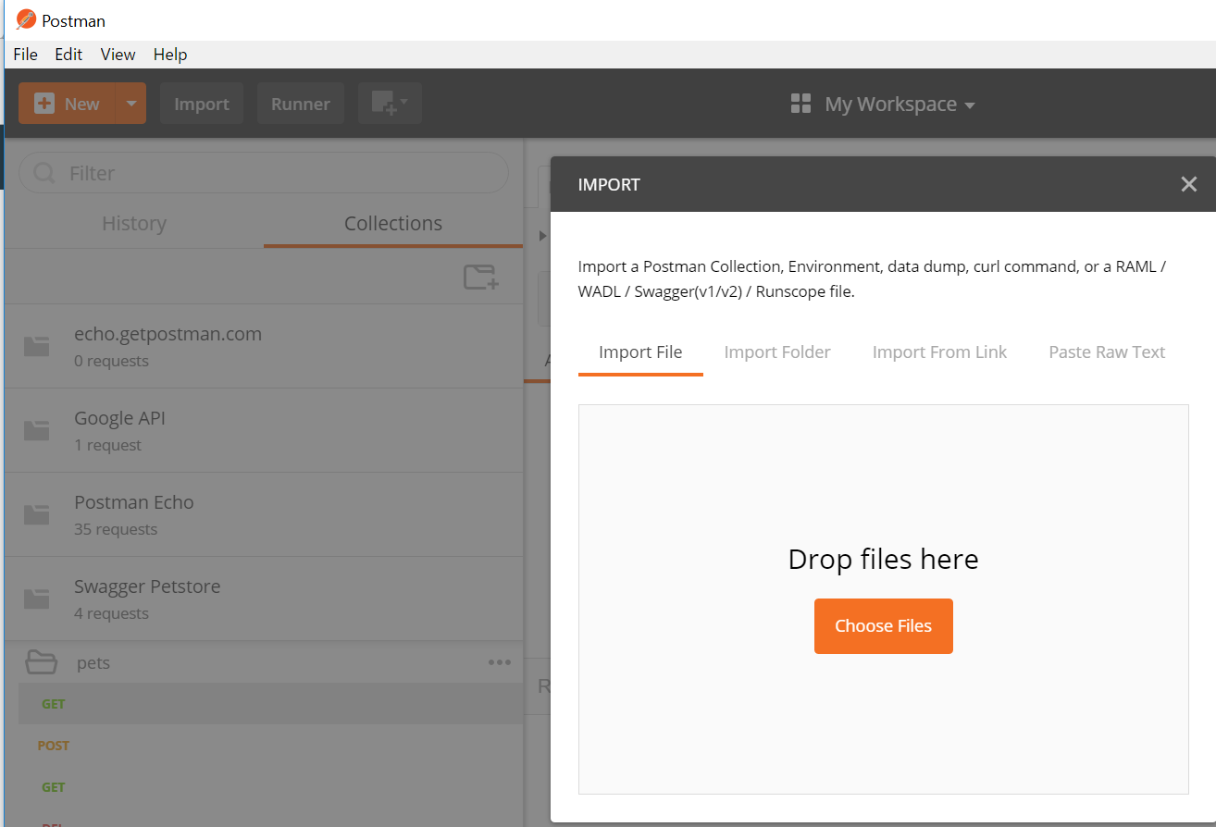
Import in the yaml file
You can paste in the code as well as import the files but Postman has a character limit regarding entire APIs so to ensure the entire API is displayed (especially for bigger APIs), import the whole file. Your YAML is now displayed in a Workspace.

Slide 7
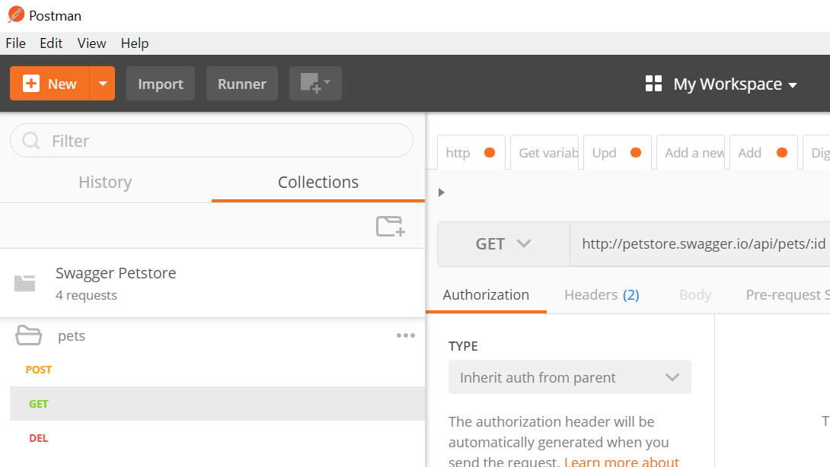
Using the requests to create tests
Decide on the logic and sequence of your tests / your test “plan”
You can drag and drop the requests around to get the sequence you want
This can be something like:
POST – create a new pet
GET – view the new pet
PUT – update the pet
GET – view the update
DELETE – delete the pet
GET – view the deleted pet

Slide 8
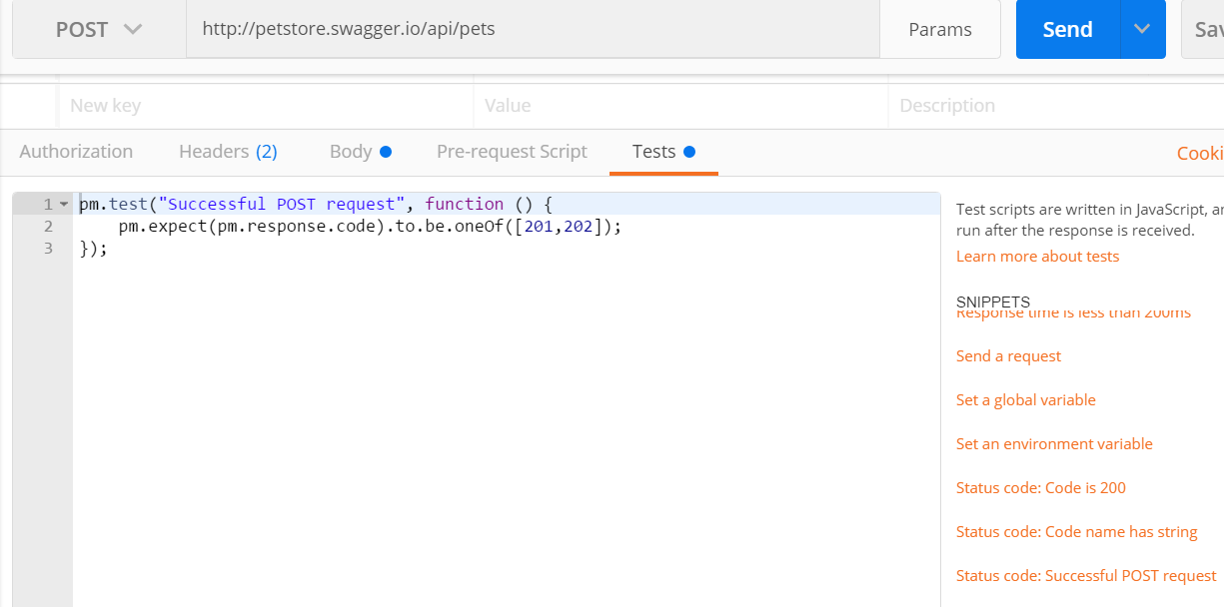
Adding a pre-canned test- request response
Open the tests tab – For the POST test – add the test for a successful POST request
You can add additional Response codes to the pm.expect(pm.response.code).to.be.oneOf([201,202]); line
If you want to check for an unsuccessful POST – what would you change the code(s) in the square brackets to?

Slide 9
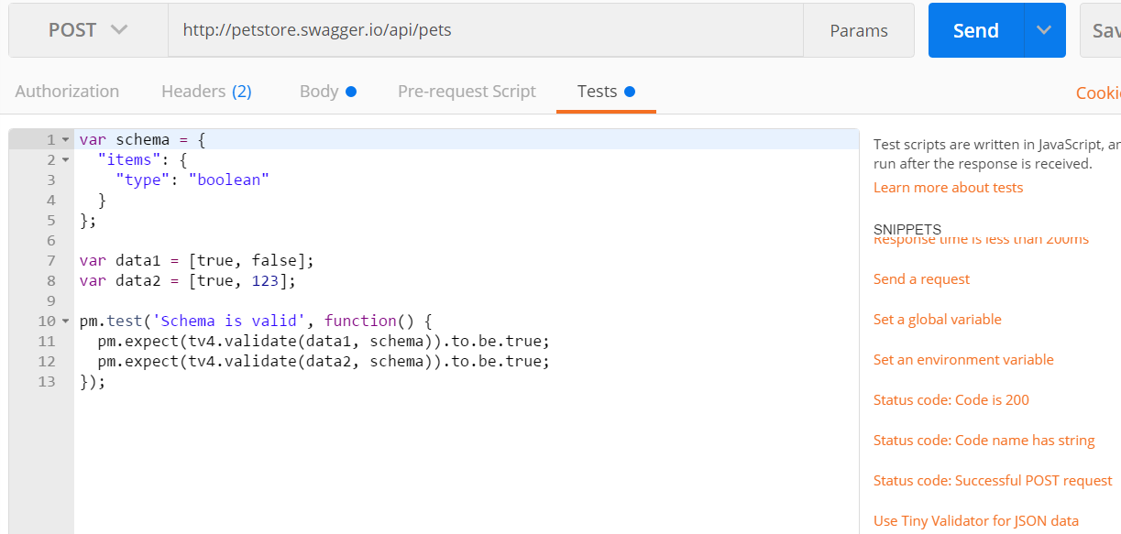
Adding a pre-canned test- Validate json
Go to the tests tab and select another one of the orange pre-canned tests and edit the code to change the context

Slide 10
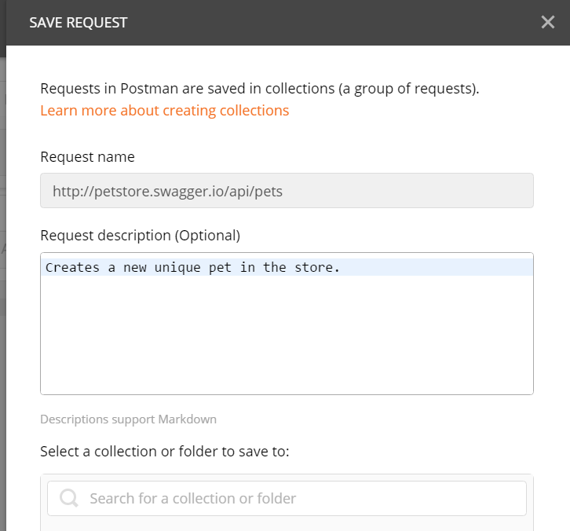
SET
Save the request to also save the associated tests. Give the tests logical names to make it easier for others to inherit and re-use your tests.

Slide 11
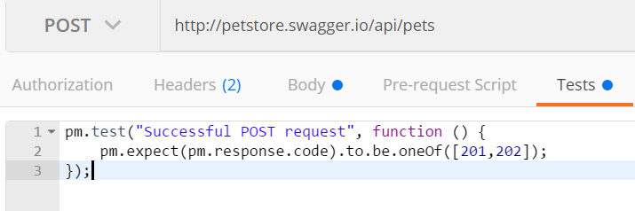
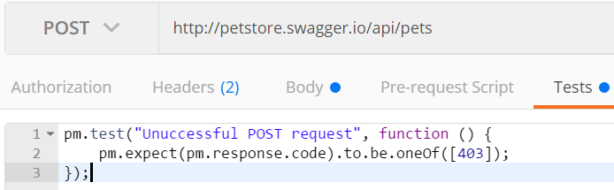
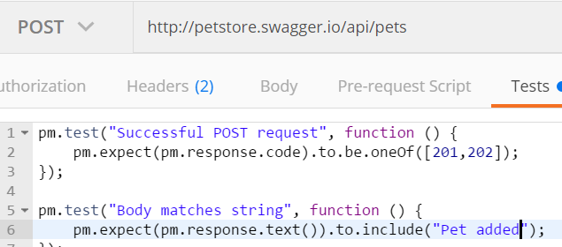
Example verifications
Positive responses to GET, POST, PUT, DELETE requests GET a pet that exists
Negative responses to GET, POST, PUT, DELETE requests PUT a pet that does not exist
Message body contains string / integer /integer + string Test for a string being returned Test for a string not being returned

Slide 12
Now what
Add some more tests to the pet store
Sync your code to GIT so you can play with it later
http://blog.getpostman.com/2017/03/10/backup-and-sync-your-postman-collections-on-github/?_ga=2.148004855.1319548834.1522151814-601390089.1522151814
Read more! (links on next page)
Automate an internal company REST API (or a publicly available one)
It does not matter if all the tests fail, the important thing is to get practice in designing tests in this way

Slide 13
More reading:
Introduction to REST Requests
Testing GET Requests
Testing POST Requests
Testing PUT Requests
Testing PATCH Requests
Creating a Postman Collection
Building workflows - Postman

